Slide 1
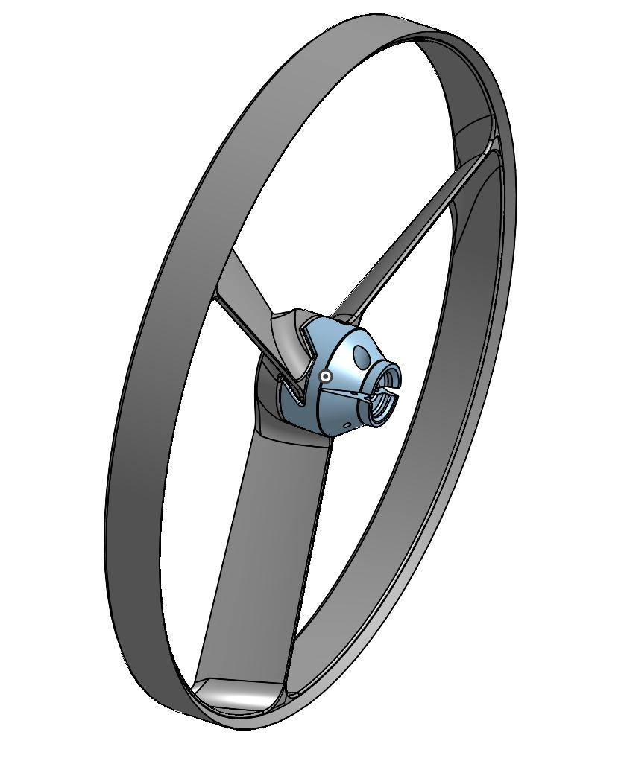
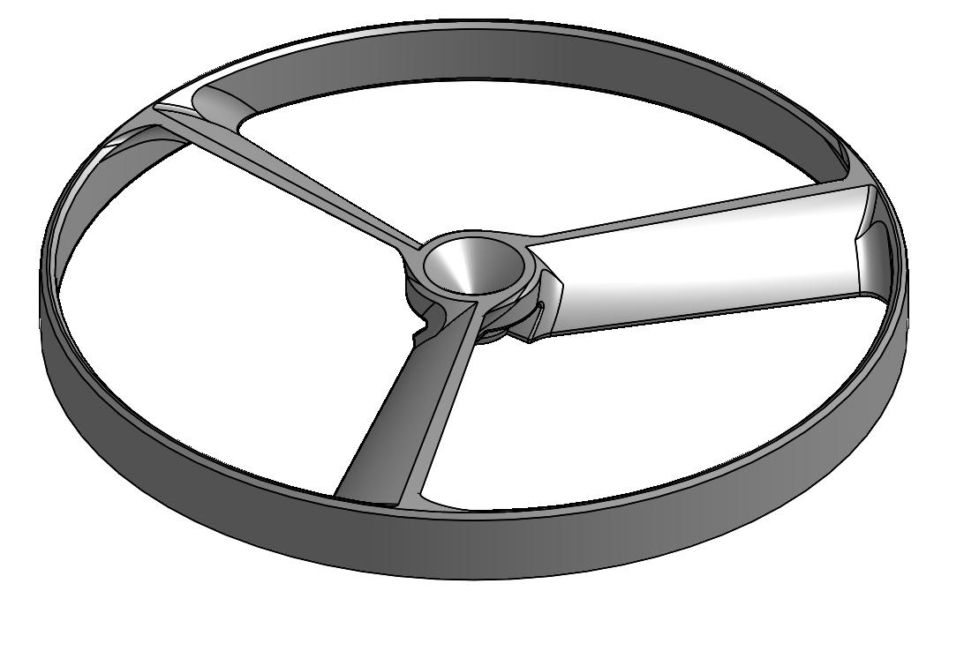
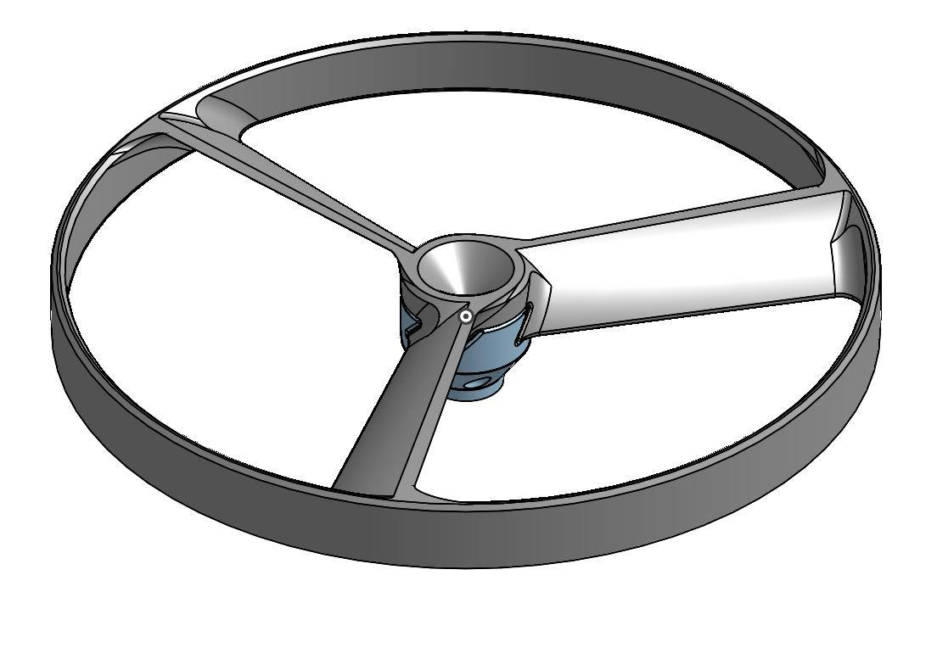
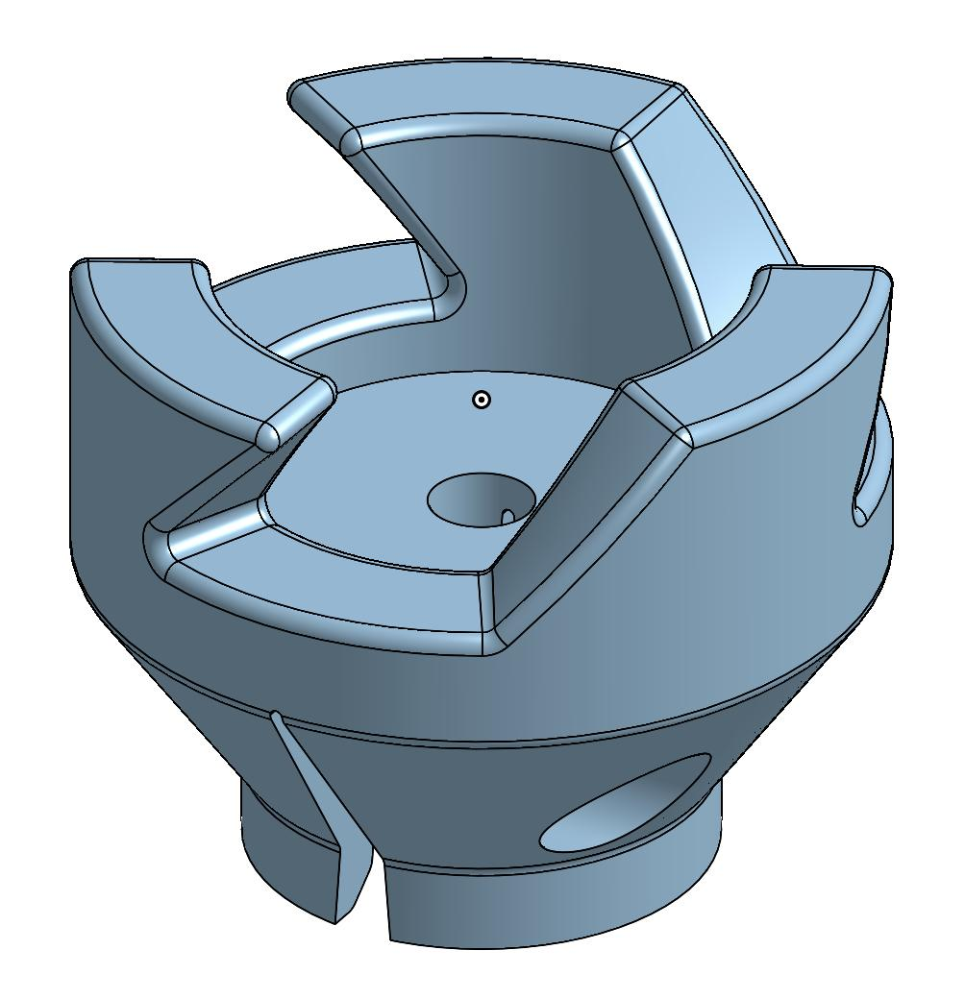
SILVER LIGHTING
Specs:
curves for better aerodynamics(airflow) and thermodynamics
3 bendable blades for better air resistance
Removable blades, can add or remove or exchange blades
Hub embedded in propeller so doesn’t crack over time, based on extreme temperature (weather and also by using)
Diameter of propeller: 6.102in approx. 152mm
Diameter of base(attach to shaft): 0.623in
Weight of entire propeller: approx: approx. <8.5lbs
Special Features:
Sensors such as maximum wind warning, temperature warning, speed and also a GPS
Better handling, performance and drag
Altitude control, for not hitting trees and other stuff which can break the propeller
Better and efficient design
Smartphone app for tracking performance, speed, agility and many more
Machine Learning, learns as you do.
RPM’S revolutions per minute in app
Can connect and code to change output such as maximum speed and rpm’s
Torque vectoring - a technology employed in differentials that has the ability to vary the torque to each half-shaft with an electronic system. Mostly, used in automobiles
Better top speed performance
Shut off electronics when needed, so you can still use full potential and no weather damage in long term

